Slide 1

RAMAIAH INSTITUTE OF TECHNOLOGY, Bangalore
(Autonomous Institute Affiliated To VTU)
Dept. of Electronics and Telecommunication Engineering
SMART GLASSES FOR PEOPLE WITH HEARING AID
Submitted by:
Harsh Vardhan Singh(1MS20ET023)
Under the guidance of:
Dr. KUSUMA S M
dept of ete, RIT
Tarunay Shrivastava(1MS20ET053) Utkarsh Soni(1MS20ET054) Sahana N G (1MS20ET042)

Slide 2
Table of Contents
▶ Abstract
▶ Introduction
▶ Objective
▶ Methodology
▶ Literature Review
▶ System design of project
▶ Implementation and code
▶ Results and Discussion
▶ Conclusion and Future Scope

Slide 3
ABSTRACT
▶ The smart glasses are capable of translating multiple languages, tailored to the user's preferences, thus facilitating broader communication in diverse settings.
▶ Furthermore, the integration of AI technologies, such as OpenAI's ChatGPT, enhances user interaction by enabling voice commands for internet searches and other digital tasks, directly displaying the results on the lenses.
▶ Our methodology encompasses a comprehensive analysis of user requirements, hardware compatibility, and software integration.
▶ The design phase involves the selection of compatible hardware components and the development of user-friendly software interfaces optimized for the OLED screens of the glasses. Testing phases ensure the accuracy of transcription and translation, system reliability,

Slide 4
INTRODUCTION
▶ According to the survey, according 63 million people are deaf in our country.
By taking into that consideration, we built this project.
▶ The aim is to enhance the quality of life for users with specific needs
▶ Empowering deaf individuals through real-time translation and transcription capabilities in smart lenses, connecting seamlessly to a Raspberry Pi for accessible communication across multiple languages.

Slide 5
OBJECTIVE
▶ Create a user-friendly smart lens interface that shows real time transcription of the audio that the device hears.
▶ Creating a solution where all these real time transcriptions can be translated into different languages as per the persons requirements.
▶ Integration of an Artificial Intelligence using OpenAI API to access GPT 3.5.

Slide 6
METHODOLOGY
STEP 1:The project began with the selection of suitable hardware components, starting with the integration of a Raspberry Pi with an OLED display.
STEP 2:A high-quality microphone was added to the system to capture audio inputs effectively. This microphone was essential for real-time audio transcription.
STEP 3:To ensure the smart glasses had internet connectivity, a WiFi module was incorporated, enabling the device to access online translation services and
other APIs.
STEP 4:A stable and portable power supply was designed to support the continuous operation of the Raspberry Pi, OLED, and microphone.
STEP 5:For the software interface, Python was chosen as the primary programming language due to its versatility and extensive libraries. Python code was developed to manage the connection and functionality of the OLED display.
STEP 6:The next step was to add the core functionalities of the smart glasses: real-time audio transcription, language translation, and integration with OpenAI's models.
STEP 7:The audio captured by the microphone was processed using speech recognition libraries in Python. This transcribed the spoken words into text in real time.
STEP 8:The transcribed text was then passed through a translation module, utilizing cloud-based services to convert the text into the user's preferred language.
STEP 9:To enhance user interaction, OpenAI's API was integrated, allowing the smart glasses to process voice commands and provide responses directly on the OLED screen.
STEP 10:The final step involved testing and fine-tuning the system to ensure seamless integration and functionality.

Slide 7
Literature Review
▶ Jan Gugenheimera, Katrin Plaumanna, Florian Schaubb, Patrizia Di Campli San Vitoa, Saskia Ducka, Melanie Rabusa, Enrico Rukzioa [1], The Impact of Assistive Technology on Communication Quality Between Deaf and Hearing Individuals (2017)
▶
The document is a comprehensive literature review focusing on the impact of assistive technologies (ATs) on the communication quality between deaf and hearing individuals. It critically examines the role of real-time translation technologies through methodologies like focus groups and Wizard of Oz studies, highlighting that while these technologies can enhance interactions, they often interrupt communication flow and emphasize the communication deficiencies of deaf individuals. This, in turn, reinforces their subordinate societal status. The review utilizes Co-Cultural Theory to analyze these dynamics and suggests a paradigm shift in AT design philosophy—from aiding deaf individuals to 'hear' to enabling hearing individuals to 'sign.' This approach aims to foster more inclusive and balanced communication dynamics between the deaf and hearing communities.
▶
Md Mehedi Hassan, MD Ashik Mahmud, Abrar Shahrivar. Naauibuddin Sarkar. Soniov Chandra [2], Smart Spectacles for The Deaf with Voice to Text and Sign Language Integration (2023)
▶ The paper "Smart Spectacles for The Deaf with Voice to Text and Sign Language Integration" explores a novel technological solution aimed at aiding individuals with hearing impairments. It discusses an advanced eyewear device that can convert spoken language into both written text and sign language. The authors, Md Mehedi Hassan, MD Ashik Mahmud, Abrar Shahrivar, Naauibuddin Sarkar, and Soniov Chandra, focus on the system's design and practical implementation.

Slide 8
▶ E Waisberg, J Ong, M Masalkhi, N Zaman, P Sarker [3], Meta Smart Glasses–Large Language Models and the Future for Assistive Glasses for Individuals with Vision Impairments (2024)
▶
It explores the integration of large language models (LLMs) into smart glasses to enhance assistive technologies for visually impaired individuals. The study emphasizes how these advanced models can significantly improve the functionality of smart glasses by enabling more intuitive and responsive interactions. By leveraging LLMs, the smart glasses can process and understand complex commands and queries in real-time, providing users with a more seamless and interactive experience. The research discusses potential applications, such as real-time descriptive audio of surroundings and interactive assistance, which could also be beneficial for other disabilities, including hearing impairments. This technology aims to improve the independence and quality of life for individuals with vision impairments by enhancing their perception and navigation of their environment.
▶
C Zhang, K Sato, B Wu [4], A Design of Smart Glasses-Based Gesture Recognition and
Translation System for Sign Languages (2023)
▶
It presents an innovative system designed to improve communication accessibility for the hearing impaired. This study focuses on developing smart glasses equipped with gesture recognition technology that can accurately interpret sign language and translate it into spoken and written text in real-time. The paper elaborates on the technical aspects of the system, including the algorithms used for gesture recognition and the integration of translation software within the smart glasses framework. By providing a seamless translation of sign language, the system aims to bridge the communication gap between individuals with hearing impairments and those who do not understand sign language, enhancing social interactions and inclusivity. This technology represents a significant step forward in assistive devices, offering real-time communication support for the hearing impaired.
▶

Slide 9
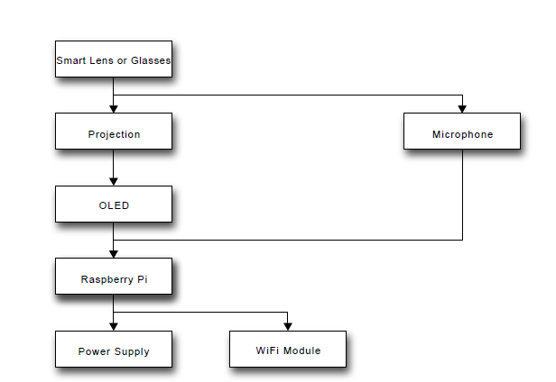
SYSTEM DESIGN OF PROJECT

Slide 10
HARDWARE REQUIREMENTS
Microphones: High-quality microphones would be necessary to capture clear audio input for speech recognition.
Raspberry Pi: Serving as the central processing unit, the Raspberry Pi would handle data processing, communication with external devices, and interfacing with the smart lenses.
Battery or Power Supply: A reliable power source, either through a rechargeable battery or constant power supply, would be essential for the smart lenses to operate.
Connectivity Modules: WiFi or Bluetooth modules would enable communication between the smart lenses, Raspberry Pi, and other external
devices.
OLED or LCD: It is supposed to be used as the screen to display the text that is recognized by the software by using the microphone.

Slide 11
SOFTWARE REQUIREMENTS
Speech Recognition Software: Advanced speech recognition software, such as Google Speech-to-Text or Microsoft Azure Speech, would be needed to convert spoken language into text.
User Interface Software: Software for designing and implementing the user interface on the smart lenses, ensuring readability and ease of use for the wearer.
Operating System: A lightweight operating system compatible with the Raspberry Pi, such as Raspbian or Ubuntu, would be required to run the necessary software applications.
Software Libraries: Libraries are required to perform a specific task that we
want to execute through a code in a particular coding language. Libraries which are used in this project are Speech Recognition library, Google Trans, OpenAI.

Slide 12
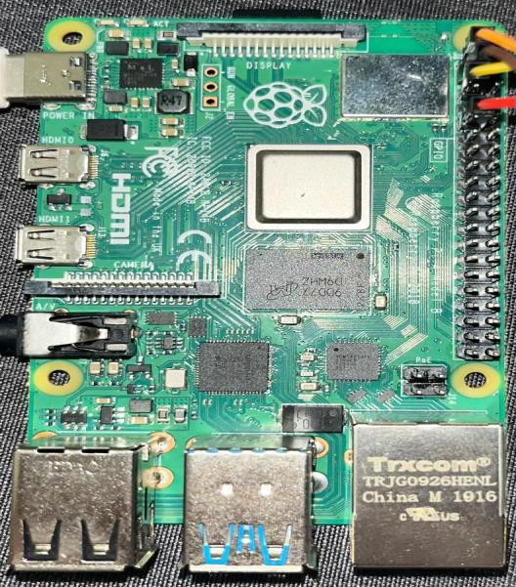
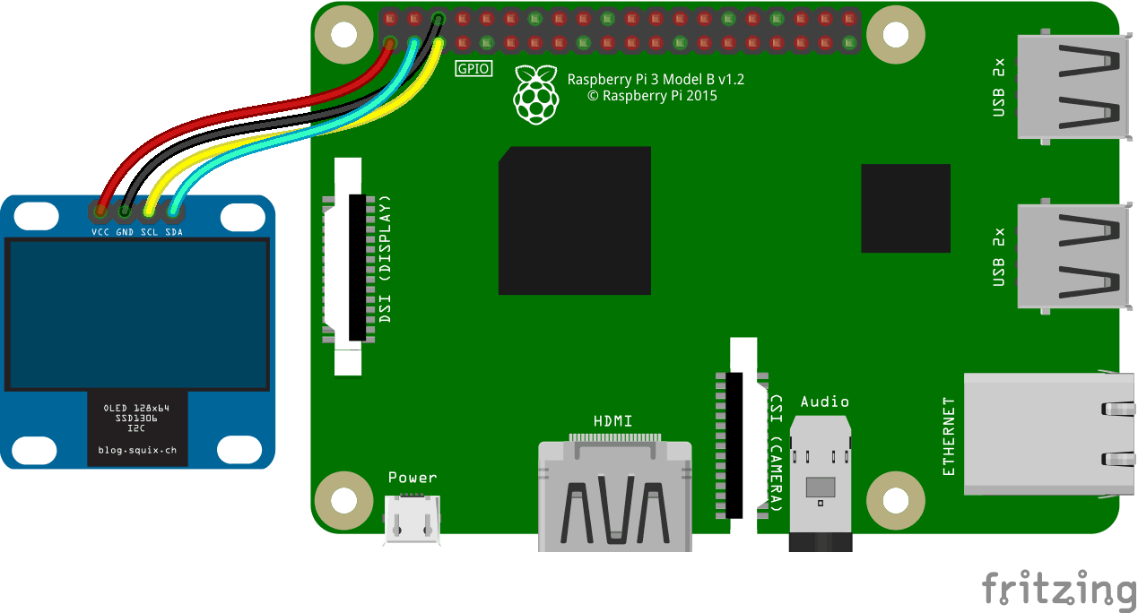
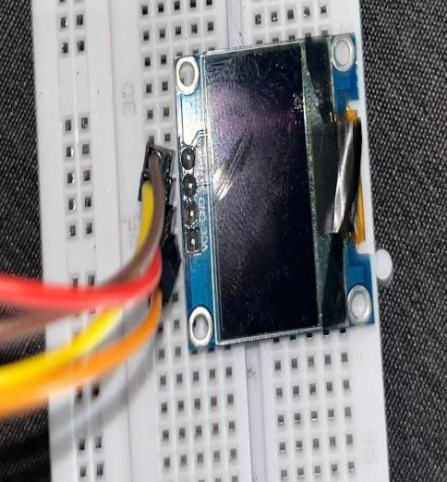
RASPBERRY PI 4
CONNECTING RASPBEERYPI TO OLED SCREEN

Slide 13
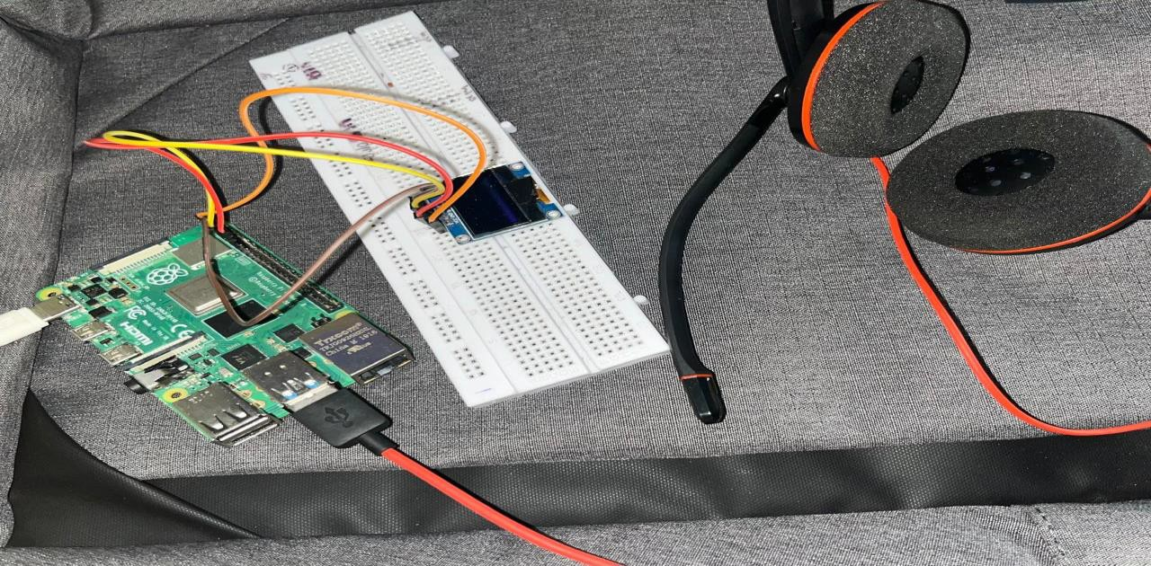
PROTOTYPE CONNECTION
VCC(OLED) - Pin 1(Raspberry Pi), GND(OLED) - Pin 6 (Raspberry Pi) SCL(OLED) - Pin 5(Raspberry Pi), SDA(OLED) - Pin 3(Raspberry Pi)

Slide 14
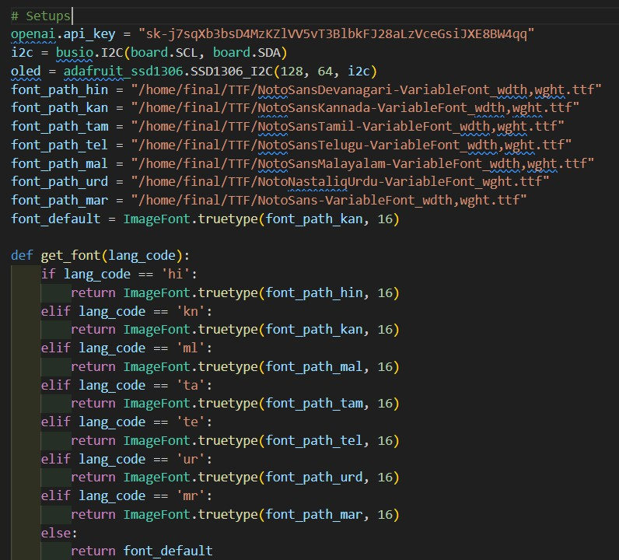
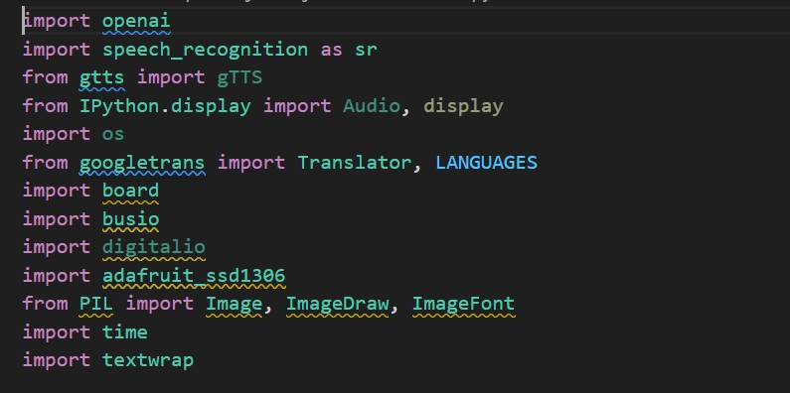
IMPLEMENTATION AND CODE
Modules and Libraries
Hardware Setup

Slide 15
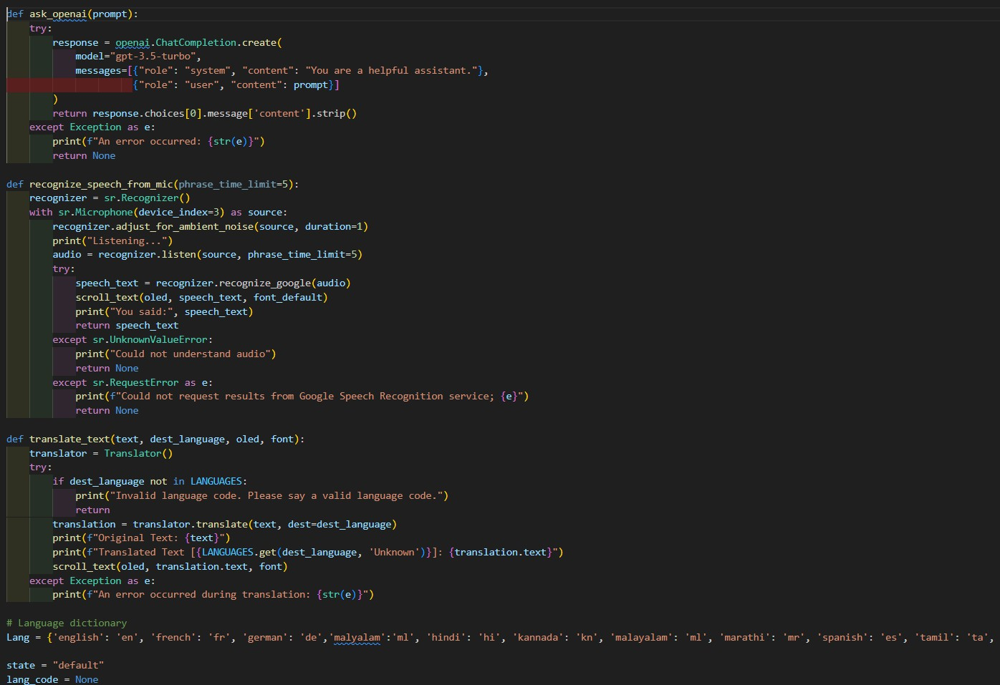
SOFTWARE SETUP

Slide 16
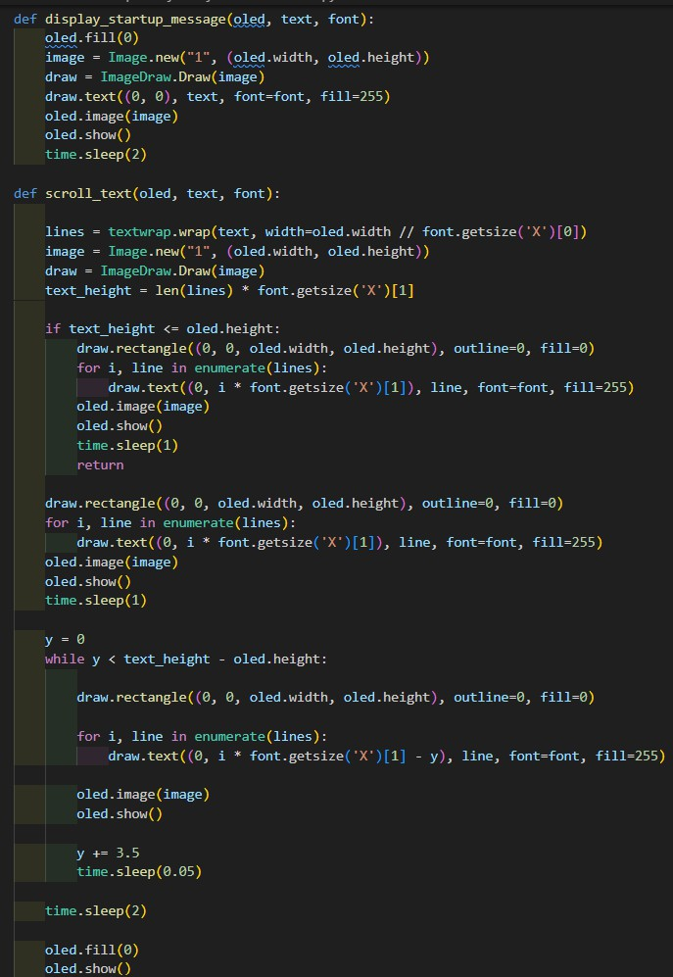
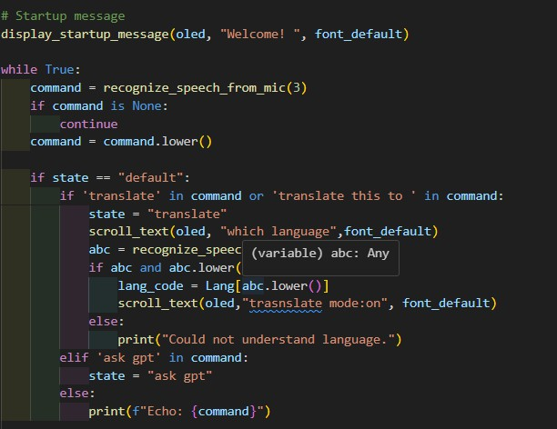
OLED Configuration Functions
: State Management: Default

Slide 17
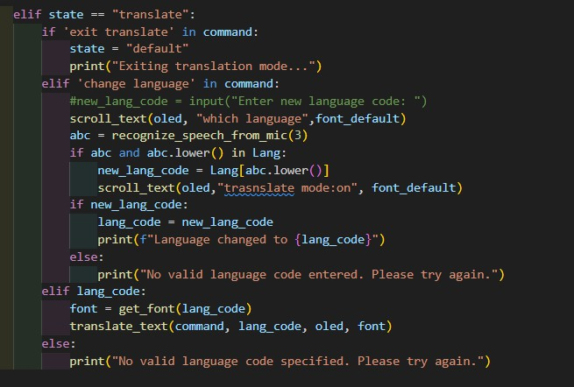
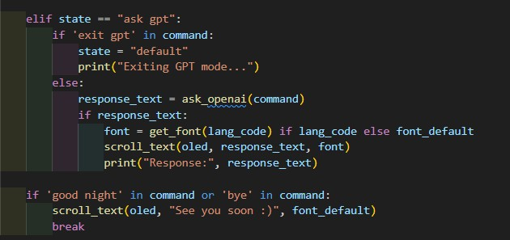
STATE MANAGEMENT : TRANSLATION
STATE MANAGEMENT:OPENAI

Slide 18
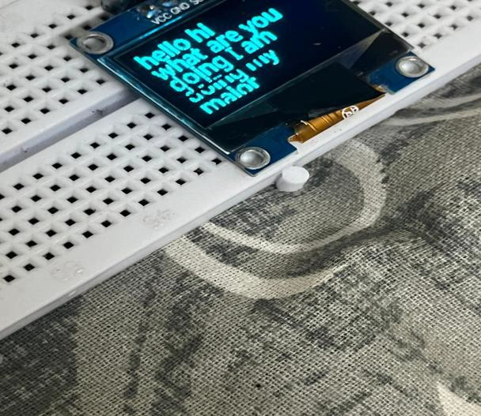
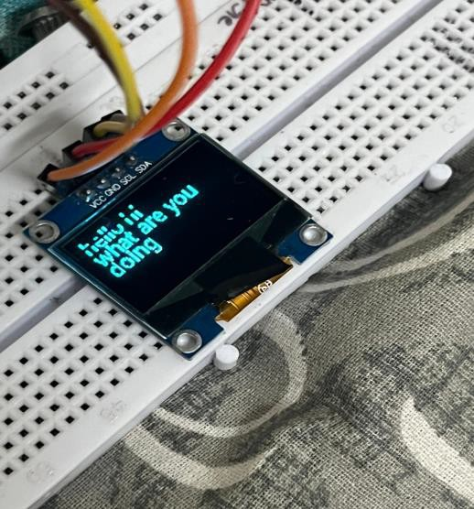
RESULTS AND DISCUSSION
.REAL TIME TRANSCRPTION
Development of a smart lens interface that provides real-time audio transcription has been done. The integration of a microphone with the smart glasses allows the system to capture audio input effectively. The audio data is processed by the Raspberry Pi, which runs a speech- to-text algorithm. The transcribed text is then displayed on the OLED screen embedded in the smart glasses. This feature ensures that users can see a live transcription of conversations or environmental sounds, making it particularly useful for individuals with hearing impairments or in noisy environments

Slide 19
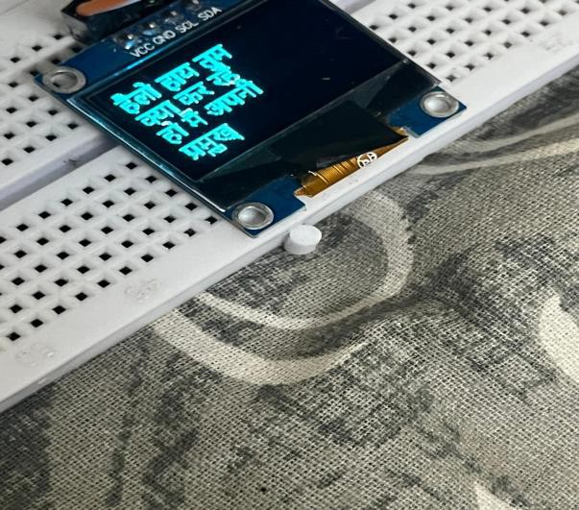
Language Translation of Transcriptions
The next objective was to translate the real-time transcriptions into different languages as per the user's requirements. So, implementation of a language translation module that interfaces with the real-time transcription system has been done. Utilizing cloud-based translation services via the WiFi module, the transcribed text can be instantly translated into the desired language. The translated text is then displayed on the OLED screen, providing a seamless multilingual experience. This feature is beneficial for users in multilingual settings, facilitating better communication and understanding
Real-Time Translation (Hindi)

Slide 20
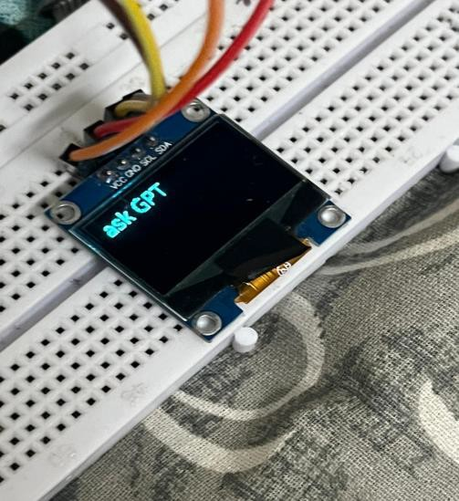
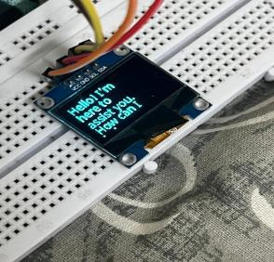
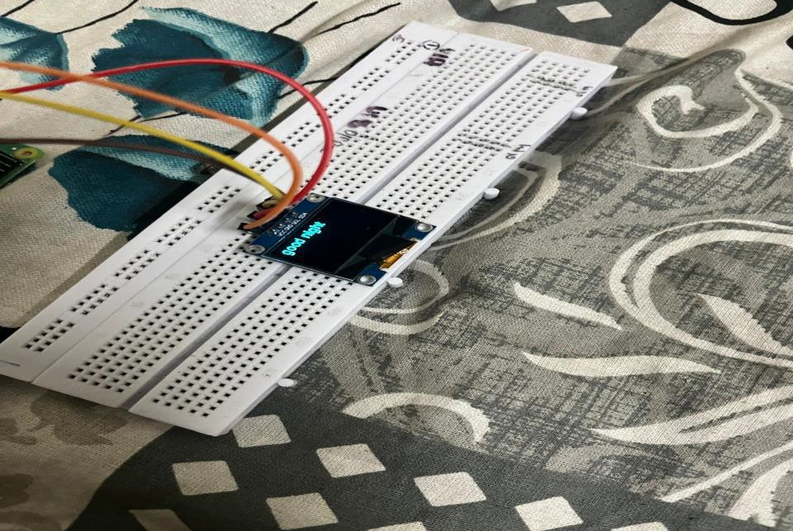
Activation of GPT
Prompt is given
GPT Respond

Slide 21
CONCLUSION AND FUTURE SCOPE
▶ The system's effectiveness is driven by the efficient use of a Raspberry Pi as the central processing unit, managing audio processing, transcription, translation, and communication with the AI model.
▶ The user-friendly interface and clear display provided by the OLED screen contribute to a seamless user experience.
▶ This project not only demonstrates the feasibility of combining these advanced technologies into a wearable device but also highlights the potential for significant practical benefits in everyday use.
FUTURE SCOPE
▶ Enhanced Battery Life
▶ Miniaturization and Weight Reduction
▶ Improved Audio Processing
▶ Expanded Language Support
▶ Advanced AI Integration
▶ Security and Privacy

Slide 22
THANK YOU
.

